Slide 1
An Introduction to Apache Spark
Performance Tuning

Slide 2
Different parts of Spark Job to optimize
Code-level design choices (e.g., RDDs versus DataFrames)
Data at rest
Joins
Aggregations
Data in flight
Individual application properties
Inside of the Java Virtual Machine (JVM) of an executor
Worker nodes
Cluster and deployment properties

Slide 3
Implement monitoring and job history tracking
To figure out how to improve performance
To know whether you’re really improving job performance.

Slide 4
Indirect Performance Enhancements
Design Choices
Scala versus Java versus Python versus R
Depending on the use case
Data at Rest
Making sure that you’re storing your data for effective reads later on is absolutely essential to successful big data projects.
Caching
Will place a DataFrame, table, or RDD into temporary storage across the executors in your cluster, and make subsequent reads faster

Slide 5
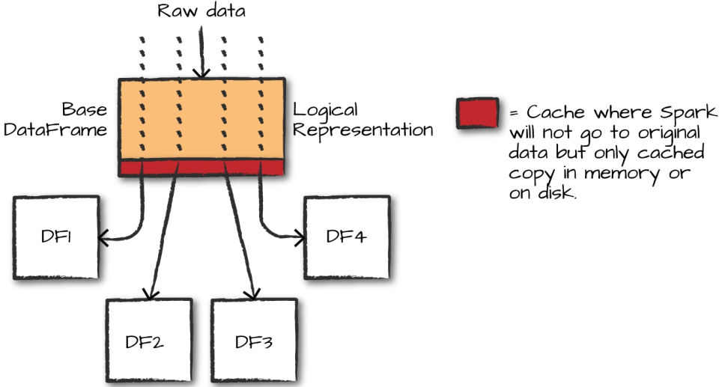
Caching
We can avoid having to recompute the original DataFrame (i.e., load and parse the CSV file) many times by adding a line to cache

Slide 6
Caching
DF1 = spark.read.format("csv")\
.option("inferSchema", "true")\
.option("header", "true")\
.load("/data/flight-data/csv/2015-summary.csv")
DF2 = DF1.groupBy("DEST_COUNTRY_NAME").count().collect()
DF3 = DF1.groupBy("ORIGIN_COUNTRY_NAME").count().collect()
DF4 = DF1.groupBy("count").count().collect()
DF1.cache()
DF1.count()

Slide 7
Caching
Now that the data is cached, the commands will be faster, as we can see by running the following code:
DF2 = DF1.groupBy("DEST_COUNTRY_NAME").count().collect()
DF3 = DF1.groupBy("ORIGIN_COUNTRY_NAME").count().collect()
DF4 = DF1.groupBy("count").count().collect()

Slide 8
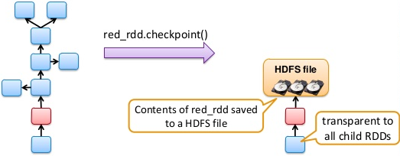
What is Check-pointing?
Saving RDD to HDFS to prevent RDD graph from growing too large
Will persist the transformed RDD or DataFrame forever.

Slide 9
When should I cache or checkpoint?
Determine if the results of a set of transformations can be reused for a very long time or not
If the answer is yes, use checkpointing
If the answer is no, use caching
Example when checkpointing would be preferred:
Crunching a RDD or DataFrame of taxes for a previous year
They are unlikely to change once calculated so it would be much better to checkpoint and save them forever

Slide 10
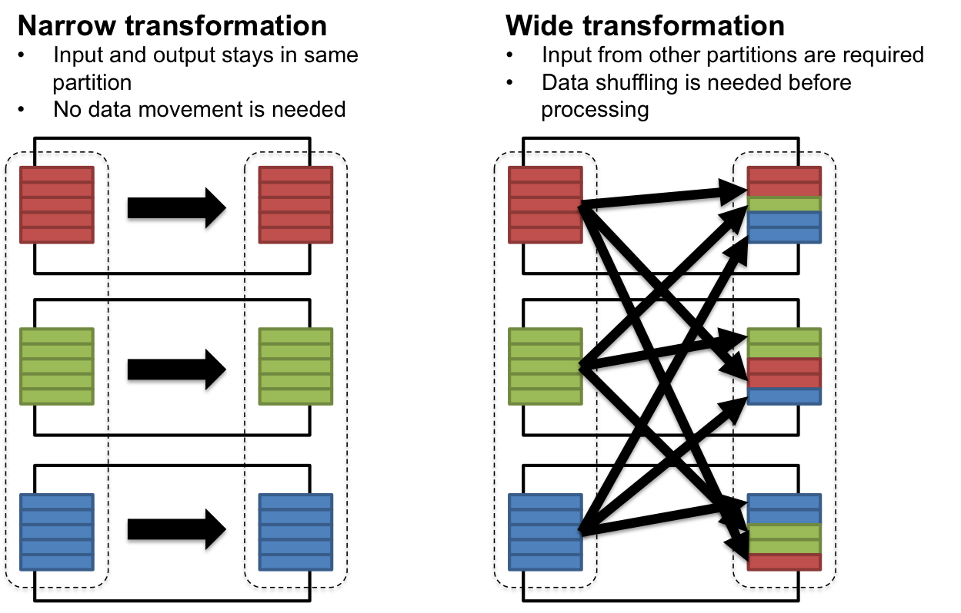
Suffling

Slide 11
Minimizing Shuffling for Increased Performance
Shuffle is an expensive operation
Each shuffling generates a new stage.
Here are some tips to reduce shuffle:
Use the Spark UI to study the plan to look for opportunity to reduce the shuffle
Use the built in aggregateByKey() operator instead of writing your own aggregations.
Filter input earlier in the program rather than later.
repartition, join, cogroup, and any of the *By or *ByKey transformations can result in shuffles.

Slide 12
Thanks

